Slide 1

as a potential car buyer, What factors contribute to owning a car in sg?
DAVI ca2
an analysis on Singapore Transport data
By: Justin wong juin hng (p2112646)

Slide 2

Introduction
Who am I?
A potential car buyer in Singapore
What am I looking to do?
I am looking to analyse Singapore’s Transport Data to give me the best bang for my buck for all aspects related to car ownership
What are my resources?
I have about 150,000 to pay for the car

Slide 3

Objectives
Introduce Visualised Data
Explain purpose of Data Visualisation
Description of Data Visualisation
Analysis of insights gathered Visualisation
Is it still viable / worth it for me to buy a car in Singapore?
Credits

Slide 4
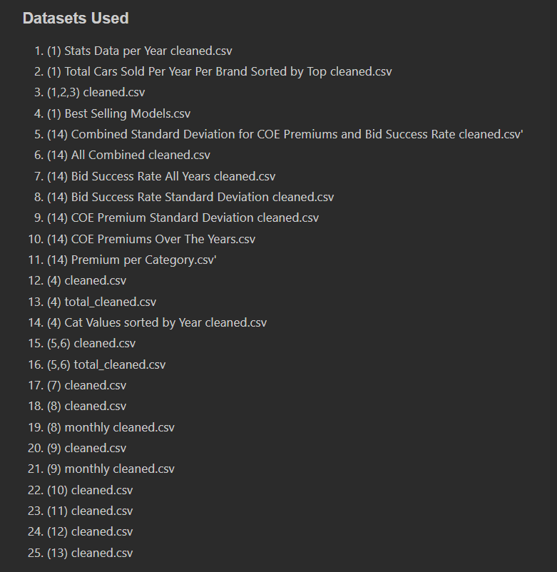
dataset(s) used

Slide 5
Objective of data analysis
As a potential car buyer in Singapore, I am looking at:
What road facilities am I provided with as a car buyer?
How much are average fuel prices?
After I’m done driving, where do I park my car?
What are the most popular brand of cars sold and their respective models? How much do I have to pay for COE?
What are the most common accidents? If I get into an accident, what are the average vehicle insurance prices
1
2
3
4
5

Slide 6
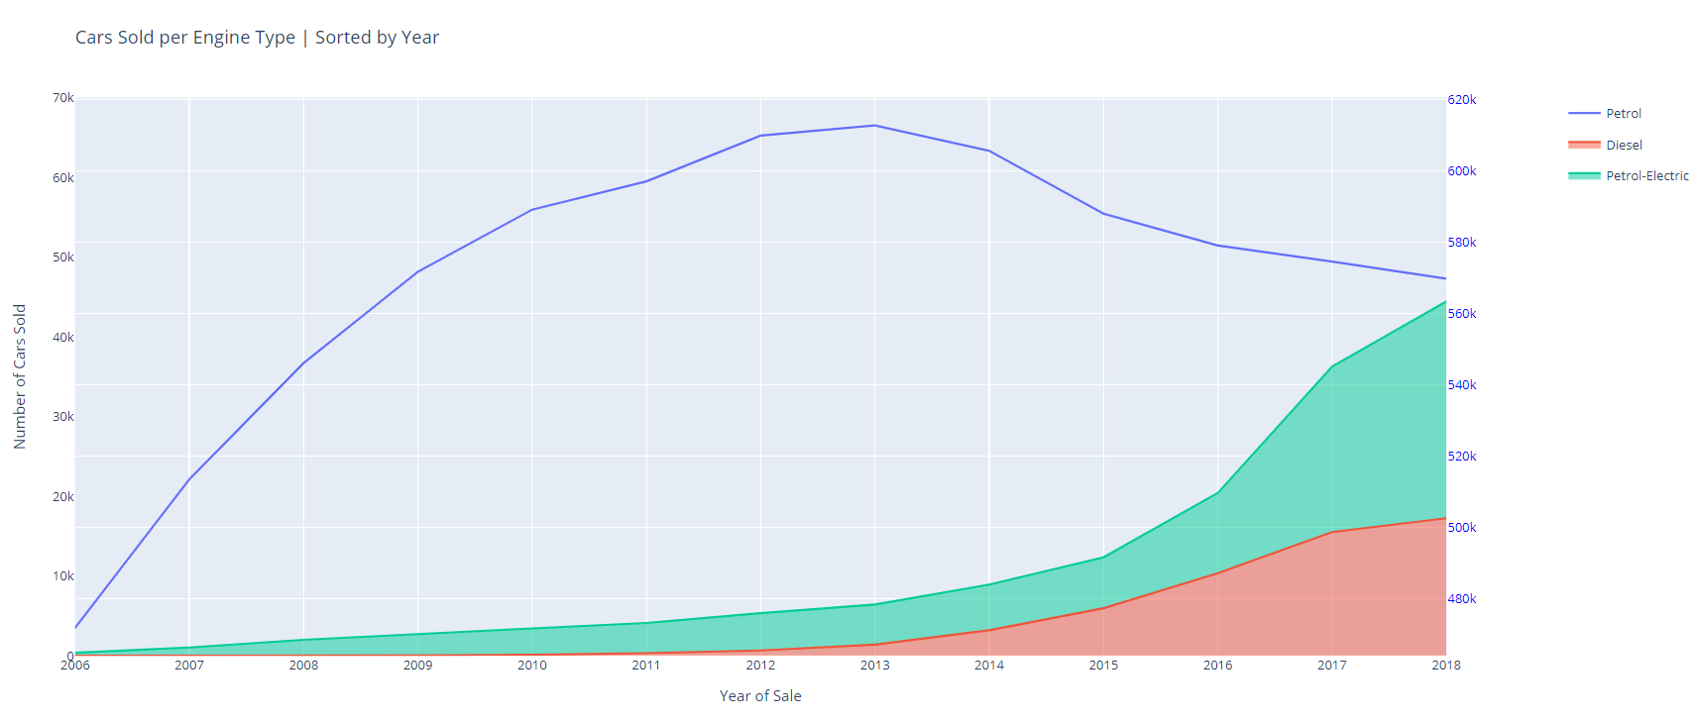
What kind of car should I buy? Why does that matter?

Slide 7
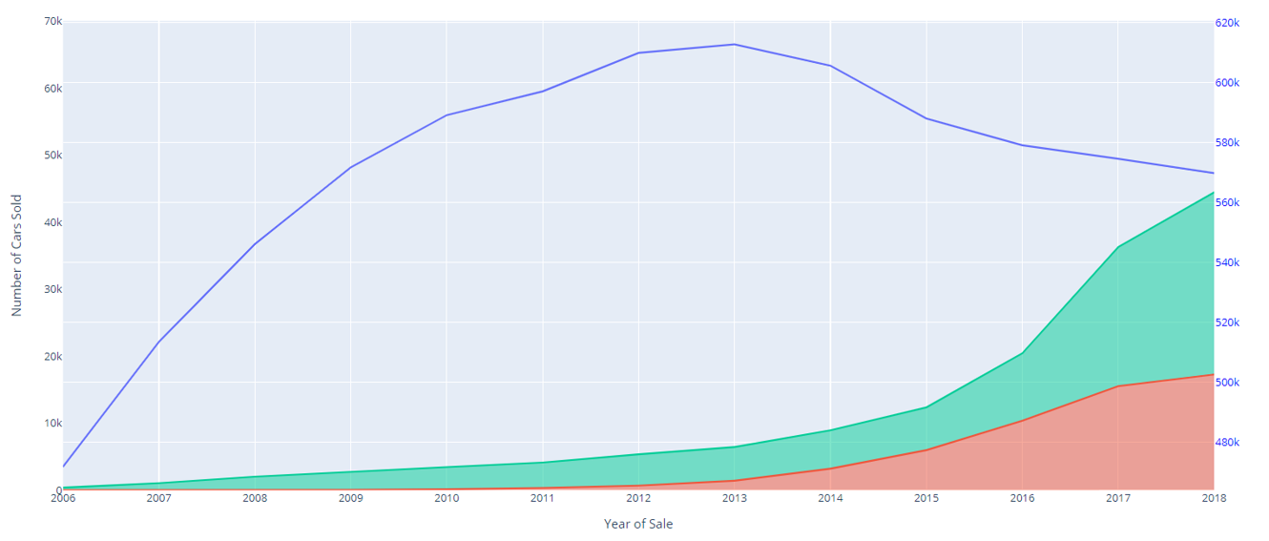
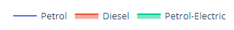
Explanation of insights
Majority of consumers still prefer to drive petrol cars
Ownership of Petro-Electric cars have skyrocketed over the past few years
Petrol cars still top the charts, due to greater availability of services such as petrol stations
However: Petrol-Electric cars are catching on,
We can see that the number of Petrol-Electric cars being sold has more than quadrupled in the last 4 years
There has also been an increase in the total number of facilities built for petrol electric cars

Slide 8
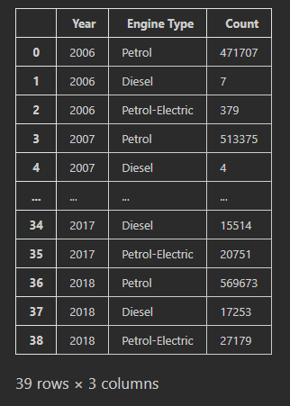
Data Dictionary
No. of cars purchased per engine type, per year

Slide 9
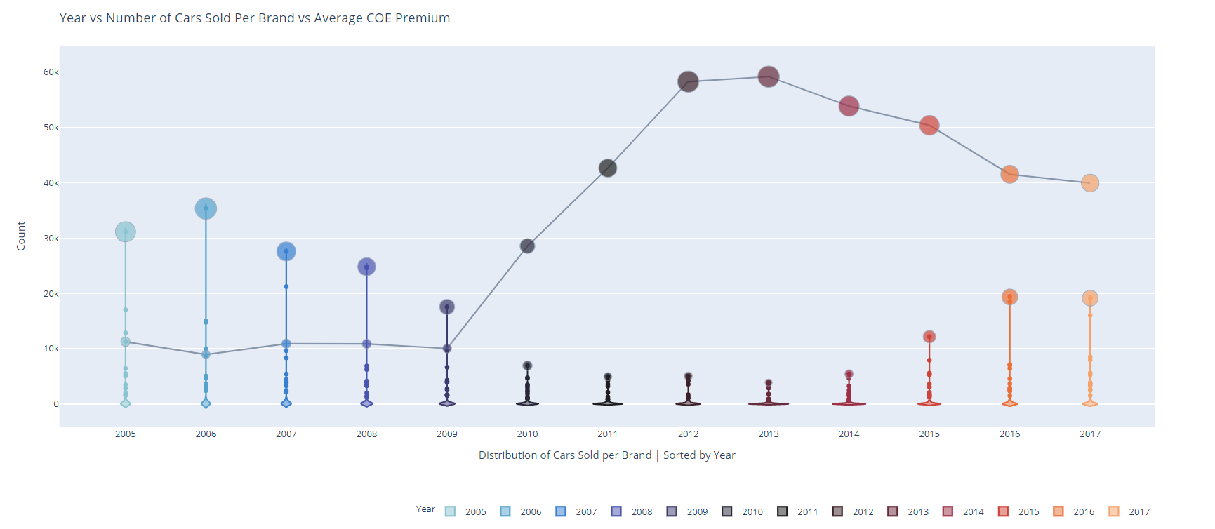
What are the most popular car brands sold over the years? What brand should I buy?

Slide 10
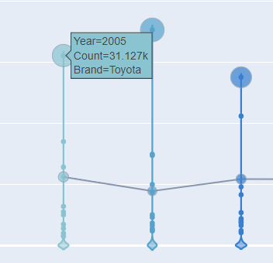
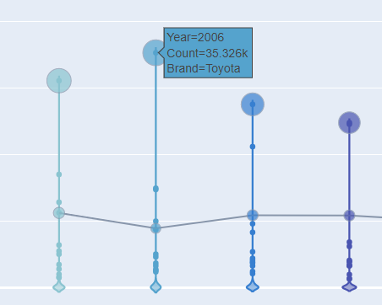
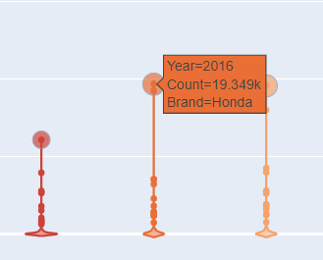
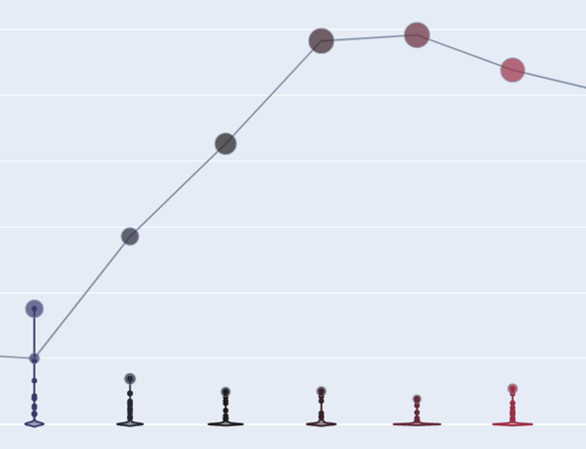
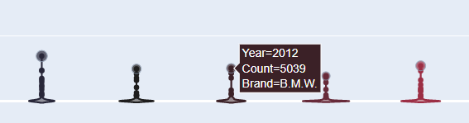
Explanation of insights
Top Brands: Toyota, Honda, with both averaging more than 15,000 models per year
Toyota easily surpassing the 15k model count, at an average of 30,000 models sold on average
Why? (Amanda S., 2022)
Toyota builds solid, efficient, and reliable vehicles
Standard safety features such as automatic emergency braking and forward-collision warning systems (WheelZome, 2022)
However:
Luxury car buyers have high disposable income, every year, they’ve been selling about the same amount
The proportion of buyers who purchase Toyota cars disappeared
The increase in COE prices did not matter to luxury car buyers, hence, the sales do not drop.

Slide 11
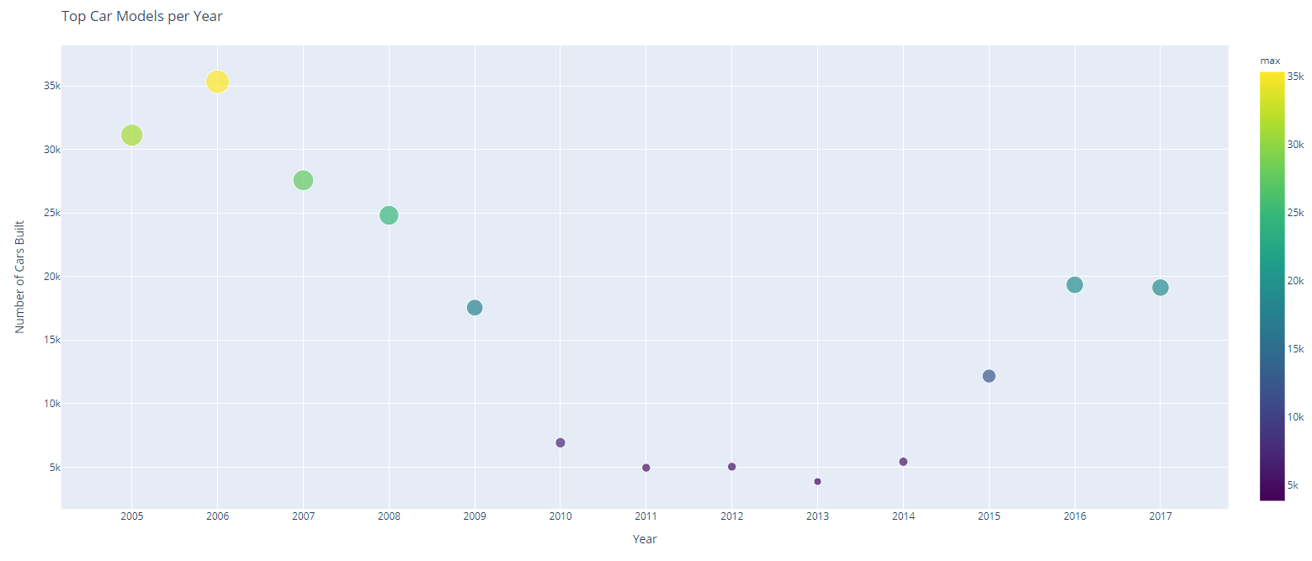
What are the most popular model of cars sold? What model should I buy?

Slide 12
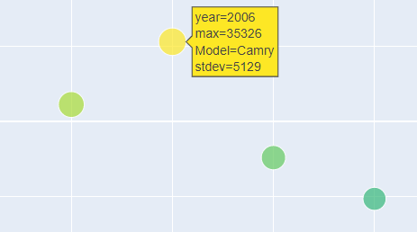
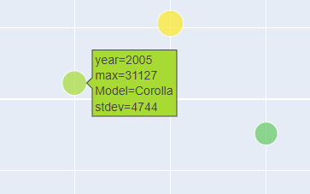
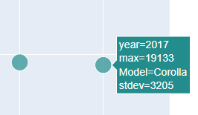
Explanation of insights
The reason why the Toyota Camry was once one of the most popular brand models for Toyota, is because:
The base four-cylinder engine on the Camry returns good fuel economy estimates.
Additionally, the Toyota Camry is:
Roomy
Has supportive seats
Has intuitive tech features
The reason why the Toyota Corolla has been one of the most popular brand models for the past 10 years, is because they are:
Simple in design
Economically priced and budget friendly
Reliable in performance and requires low maintained
Incredibly fuel efficient and have electric modes to save fuel
And it also caters to the largest consumer base, therefore selling more models

Slide 13
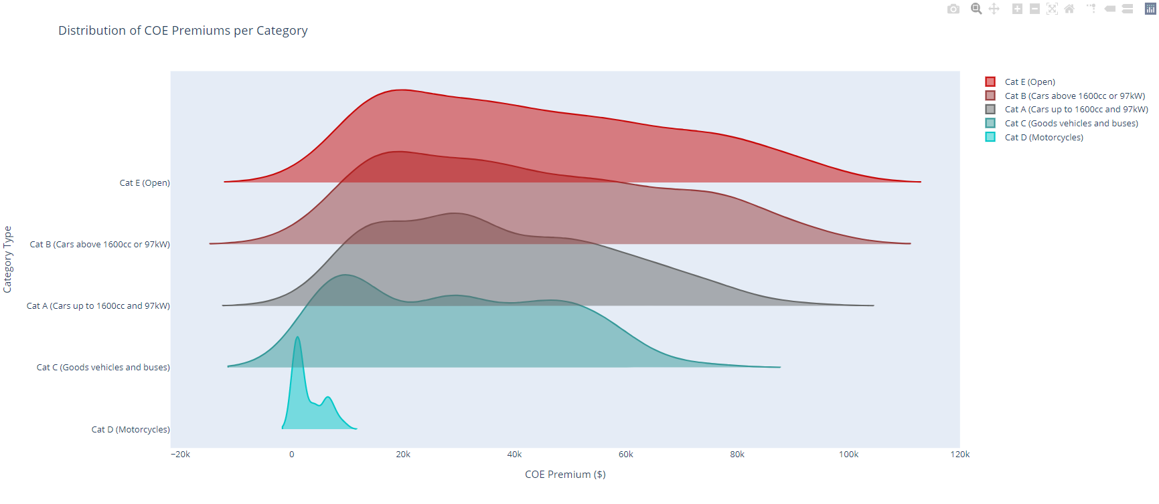
How consistent are Coe Prices per Category? What category should I stick to?

Slide 14
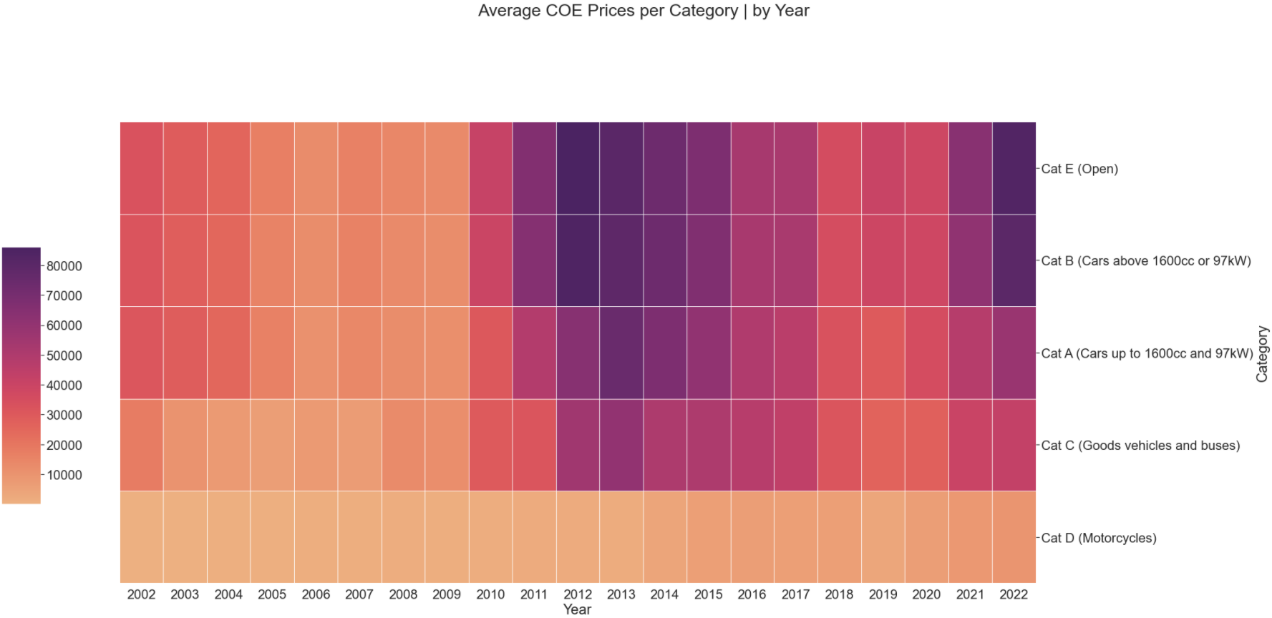
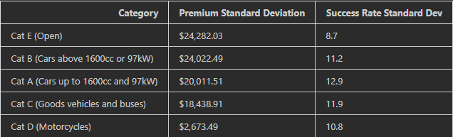
Explanation of insights
5 categories. Cats A to E
Cat A (Averaged-Price Family Cars)
Cat B (Luxury Cars)
Cat C (Buses and Vans)
Cat D (Motorcycles)
Cat E (Any Vehicle)
COE Prices for Cat B and Cat E cars are similar (both max out at $110,000
Standard deviation for COE Prices are upwards of $4,000 more than the Category A
Therefore, we can conclude that the COE Prices are very inconsistent as compared to category A
This is due to the level of customisation & variability being much higher than that of Cat A.
From Cat E to Cat A, the standard deviation for success rate in COE applications increases
Cat E consumers are more likely to get their COE approved as compared to Cat A, since the amount of people buying such cars are just simply lesser
As compared to Cat A, where the success rate is about 5% lower than that of Cat E.
Therefore, we’ll just bid higher and simply pay more

Slide 15
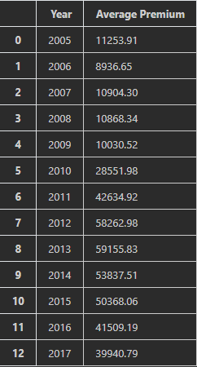
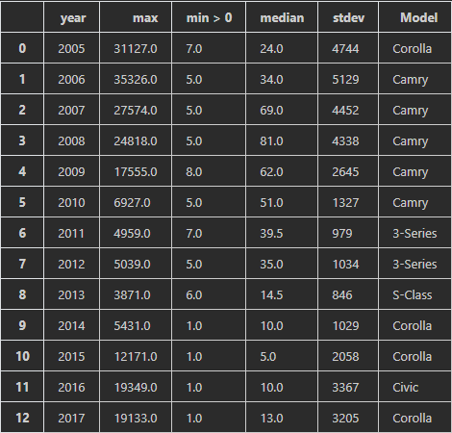
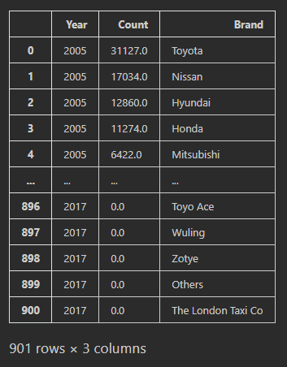
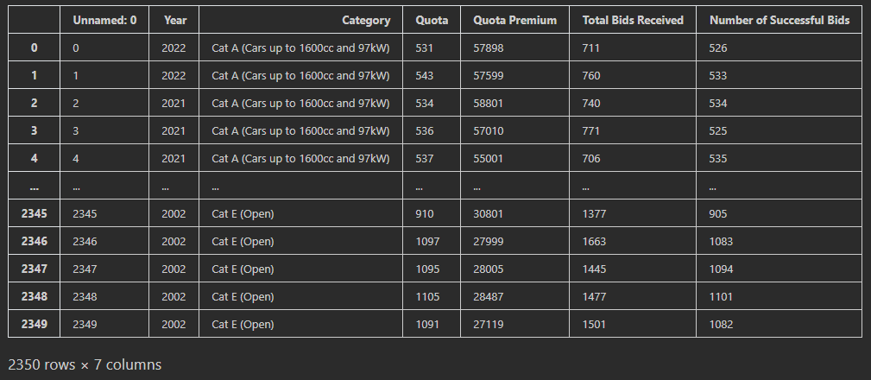
Data Dictionary
Average COE Premium per year
COE Premium statistical data per year
No. of cars sold per brand, per year
Vehicle Category Data per year

Slide 16
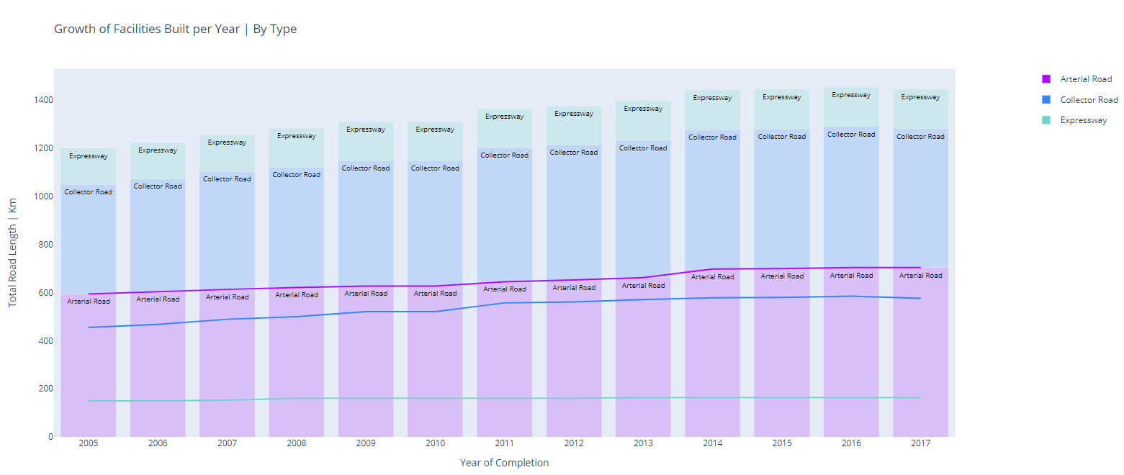
how much road is being paved each year? Why does that matter?

Slide 17
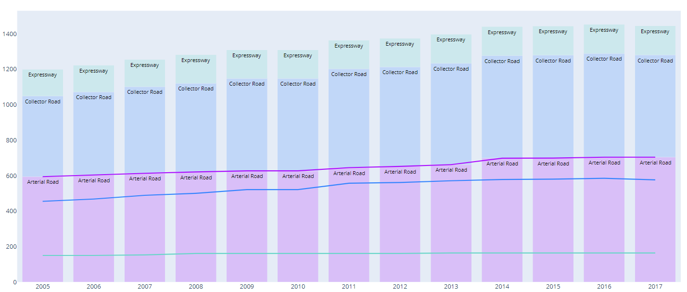
Explanation of insights
For all 3 road types, there is upward growth:
We can observe an increase from 1194 kilometers total road length paved in 2005 to 1444km in 2017
This shows an increase of 20% in just 12 years
This suggests that:
Singapore government is putting in effort to increase the interconnectivity of our island by paving more roads for us drivers to use
Therefore, if I buy my car:
There would be no need to worry about not having enough space on the road
There would also be no need to worry where my destination is

Slide 18
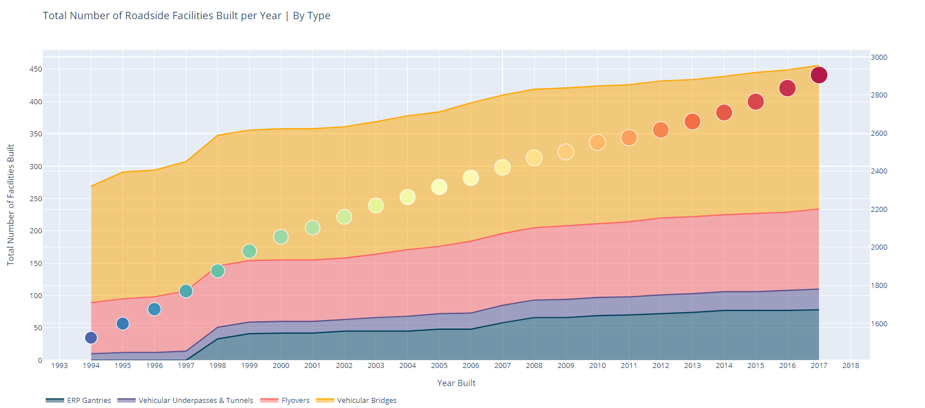
What is the growth of roadside facilities constructed? Why does that matter?

Slide 19
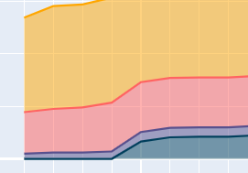
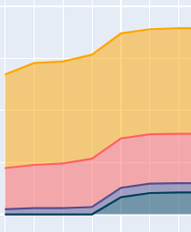
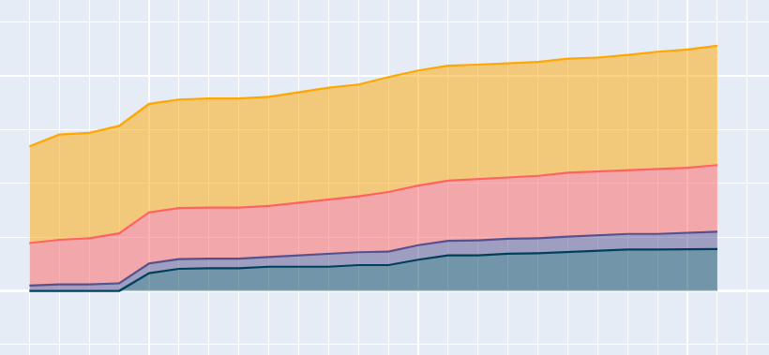
Explanation of insights
1994 to 2017, there is an upward trend in the total number of facilities constructed:
We can observe Vehicular tunnels, Flyovers and ERP gantries seeing significant growth, from 1525 facilities in 1994 to 2905 facilities in 2017, up a whopping 90%
Therefore, I can conclude that:
There are many ways and methods for me to reach my destination
There is also a lesser likelihood that I'll be stuck in a jam as there are more facilities available to reduce the average number of cars per length of road
An increased number of facilities also help in reducing congestion and waiting time during peak hours, causing lesser jams

Slide 20
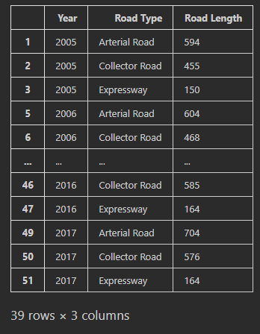
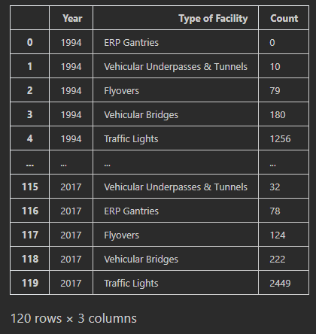
Data Dictionary
Road length paved per type, per year
No. of facilities built per type, per year

Slide 21
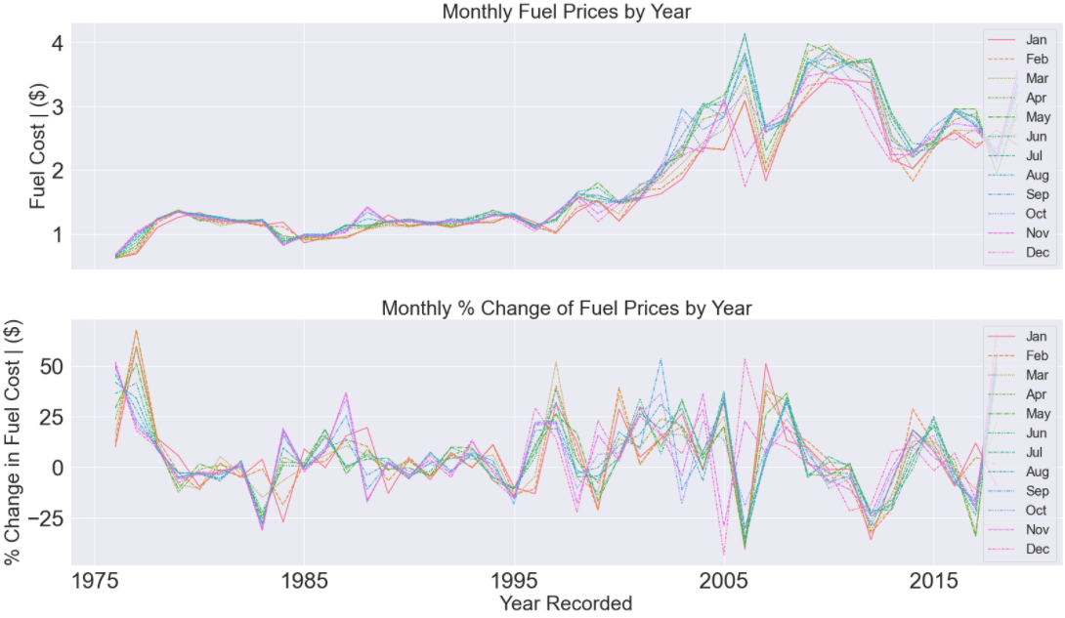
How much are fuel prices? Why does that matter?

Slide 22
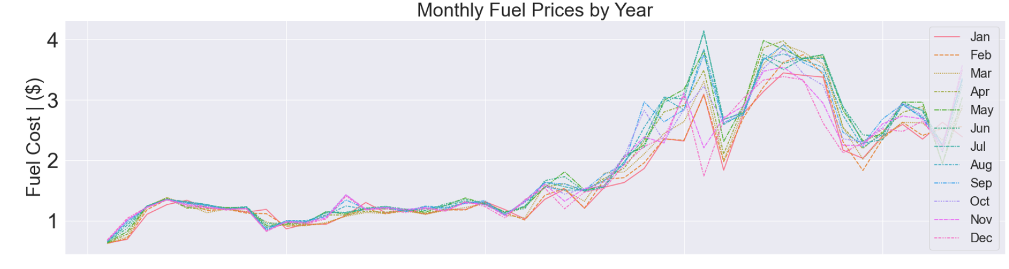
Explanation of insights
Surge in prices, from 1975 to 2020
Upwards of four times what we had in 1975
Inconsistent peaks and dips during financial bubble years like 2002-2004
But why? Extreme weather events led to longer-than-typical periods of cooling and heating (See Kit, Tang, 2022)
This results in:
fuel supplies depleted
Lack of available sources to purchase from
Since supplies would usually be replenished during winter, heatwaves and droughts in regions kept energy needs high
A rebound from COVID-19 ramped up demand from Asian economies
Supply failed to keep up
Production of liquefied natural gas worldwide has been lower than expected
Series of unplanned outages across the globe
Maintenance of gas infrastructure delayed
Thus:
European gas benchmark, Dutch TTF, has rallied 290 per cent since the start of the second quarter
Asia LNG spot prices were up 260 per cent while US natural gas prices nearly doubled over the same period.

Slide 23
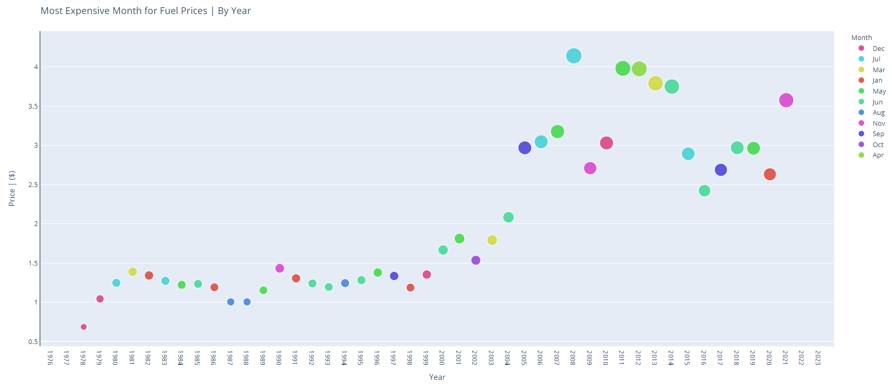
Is fuel expensive? why?

Slide 24
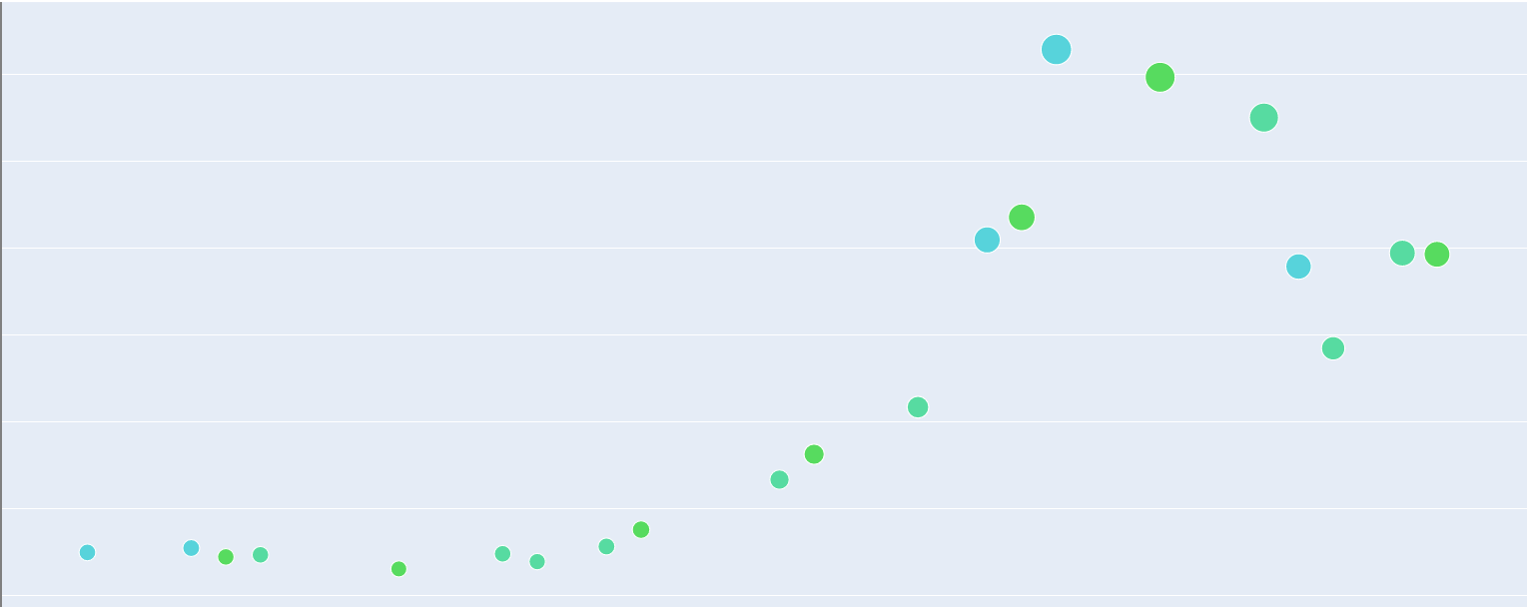
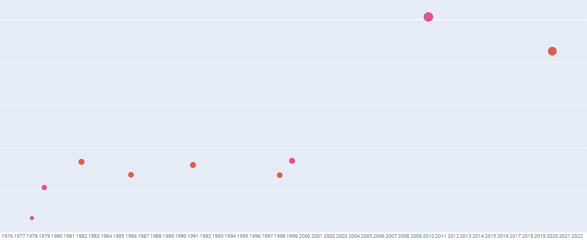
Explanation of insights
vs
Max Fuel Price Occurrences: June and July
Max Fuel Price Occurrences: Jan and Dec
Occurrence of highest fuel price is greater in June and July than that as compared to the two ends of the year
Since fuel is only imported during the winter, supplies are much higher during the January and December period. This causes:
Supplies to increase, while demand stays the same. Causing the prices for fuel go down.
Therefore: the highest fuel prices in each year do not occur as frequently during this time period of January and December.
When fuel supplies begin to run short, we can see that:
The occurrences of highest fuel prices in each year occurring more frequently during June and July, exactly matching when supplies begin to run short
Therefore: due to law of supply and demand, fuel prices get exponentially higher to cope with reduced supply and increased demand

Slide 25
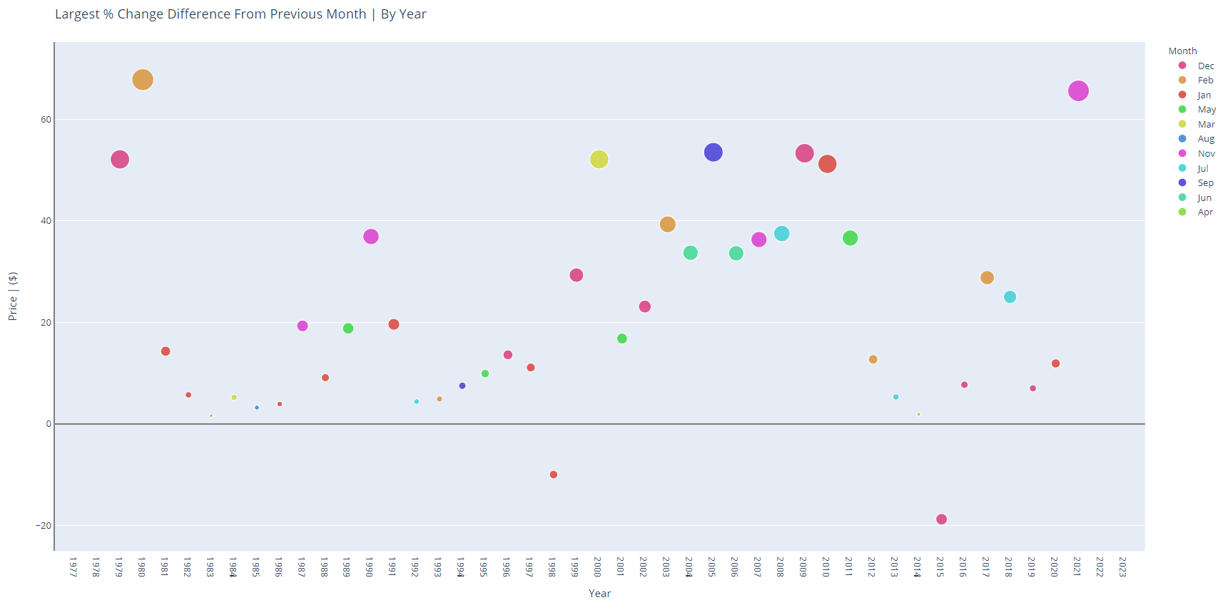
How consistent are fuel prices? When should I buy fuel?

Slide 26
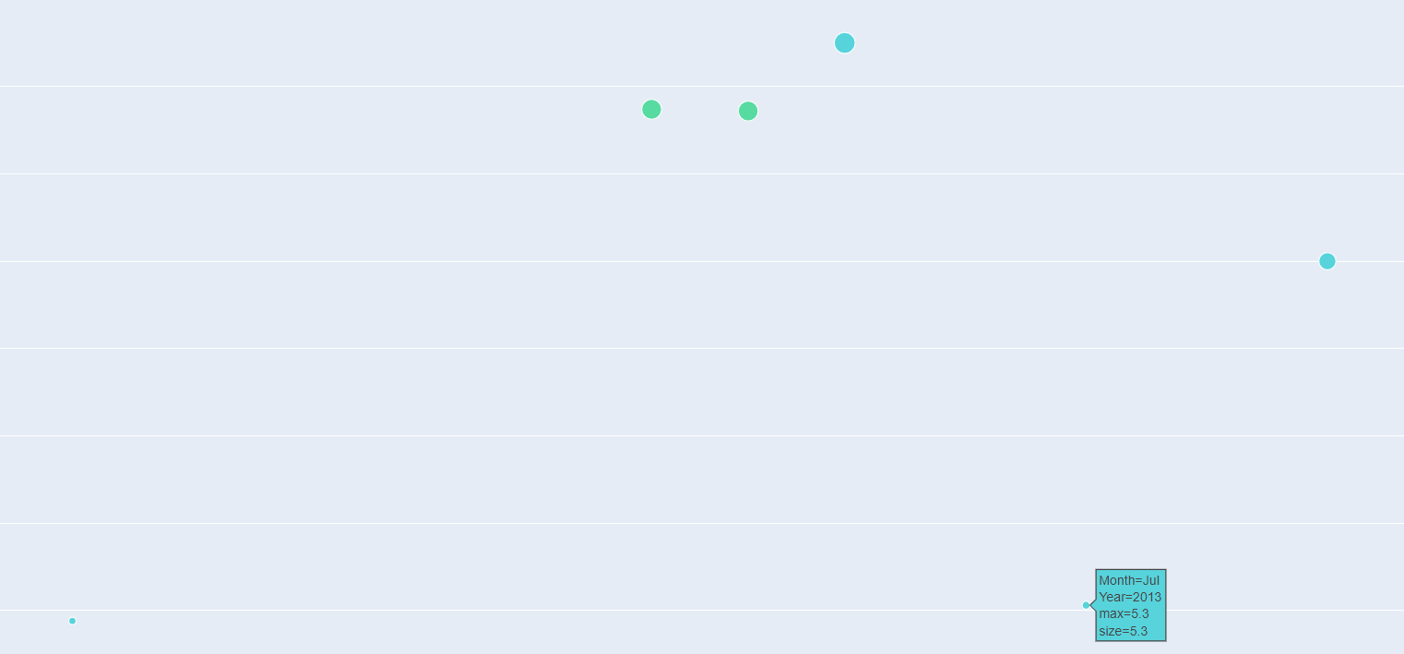
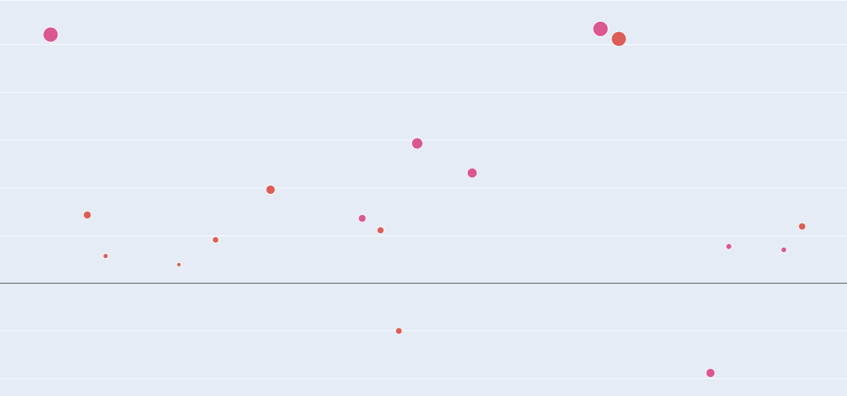
Explanation of insights
vs
Highest % Difference Occurrences: June and July
Highest % Difference Occurrences: Jan and Dec
If this the number of occurrences for each month is high, that means that fuel prices are inconsistent for that month, and vice versa.
We can observe that June and July, do not have most occurrences, since:
Prices at the end of the year, are more inconsistent than that during the middle of the year, since they have a higher count
Therefore suggesting that fuel prices are more consistent during June and July
Why?
As supplies get restocked, this causes frenzy and mayhem to occur all over the country as companies fight with one another to either lower or increase fuel prices, causing:
Constant fluctuations in fuel prices, thus causing a higher percentage difference from the previous month as compared to June and July
And due to the law of supply and demand, fuel prices get exponentially higher

Slide 27
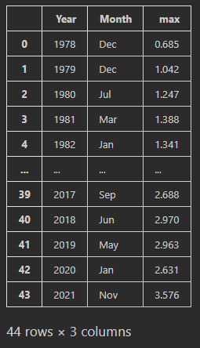
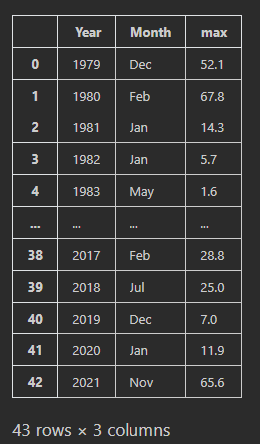
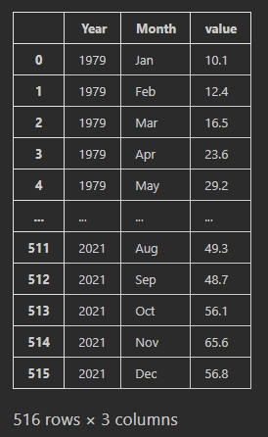
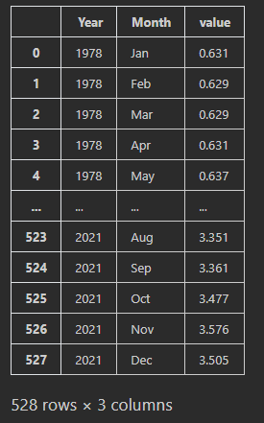
Data Dictionary
Highest fuel price per year
Highest fuel price % difference per year
Fuel price per month per year
Fuel price % difference per month per year

Slide 28
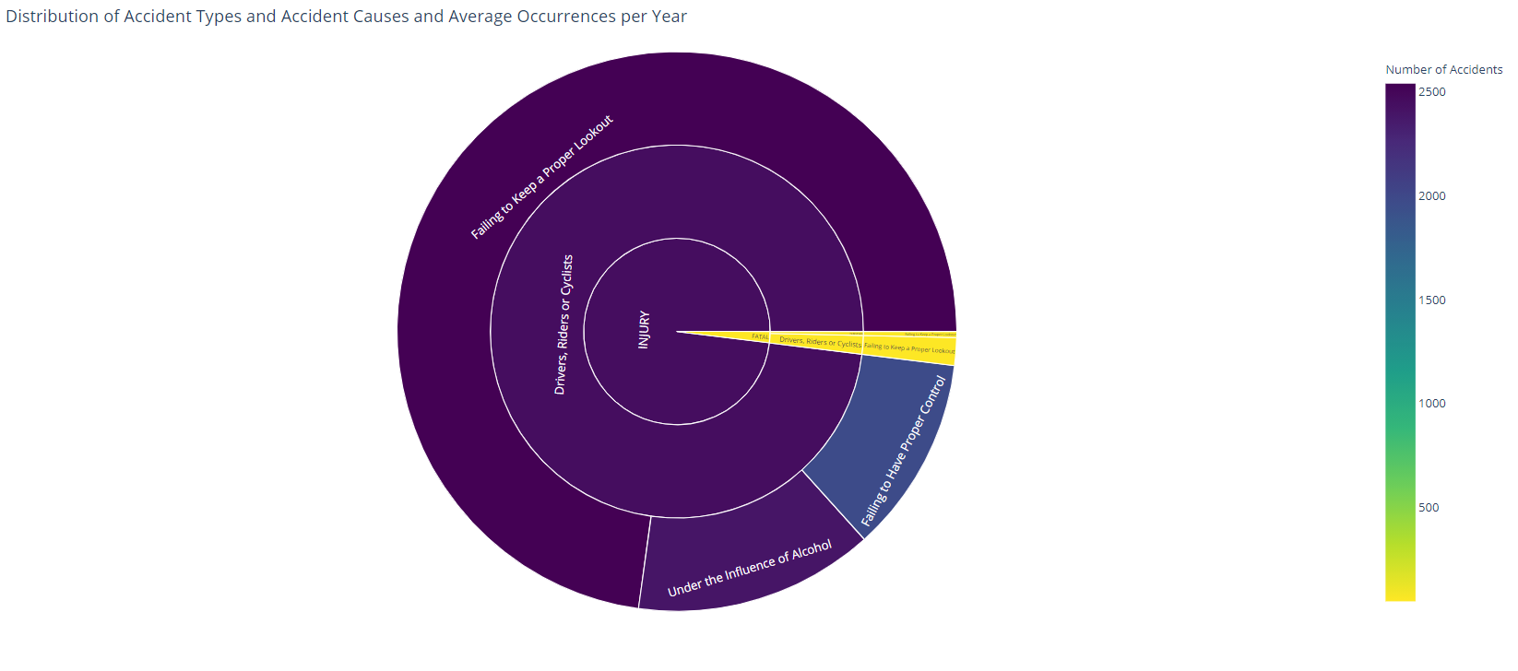
What accidents are most common on the road? Why?
Type of Accident

Slide 29
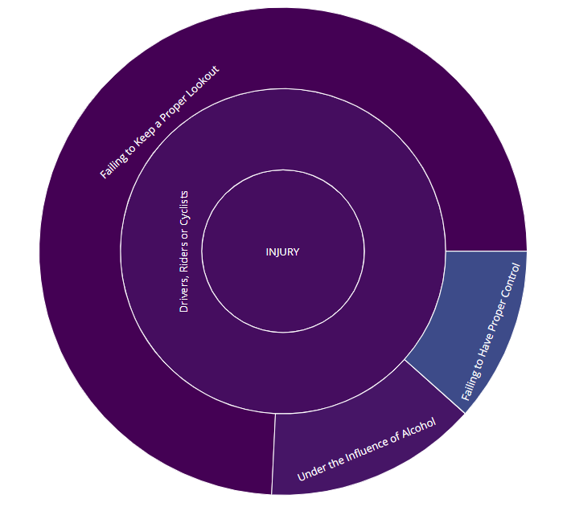
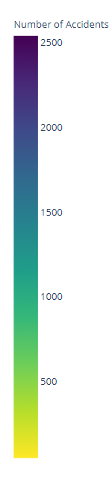
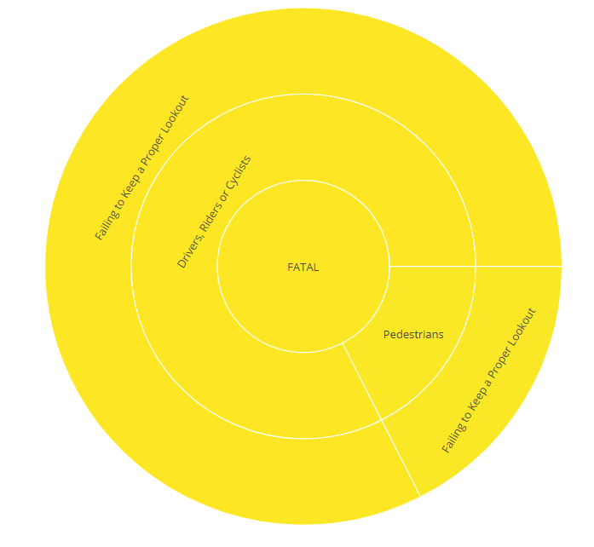
Explanation of insights
For Non-Fatal Injuries, we can observe that:
All Non-Fatal injuries occur due to Drivers, Riders or Cyclists
The majority (about 70%) of all accidents occur when Drivers fail to keep a proper lookout
Therefore, we can conclude that on average, each year, about 2500 non-fatal accidents occur due to Drivers, Riders or Cyclists failing to keep a proper lookout on the road.
For Fatal Injuries, we can observe that:
Most Fatal injuries occur due to Drivers, Riders or Cyclists, with some occurring due to Pedestrians
The majority (about 80%) of all accidents occur when Drivers fail to keep a proper lookout
Therefore, we can conclude that on average, each year, about 100-200 non-fatal accidents occur due to Drivers, Riders or Cyclists failing to keep a proper lookout on the road.
Hence, when driving on the road, we need to pay close attention to ensure we do not become one of these statistics.

Slide 30
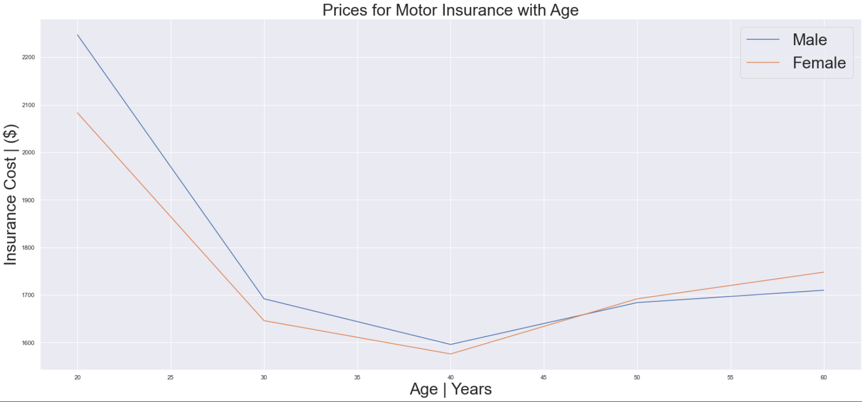
Should I purchase insurance? when should I purchase insurance?

Slide 31
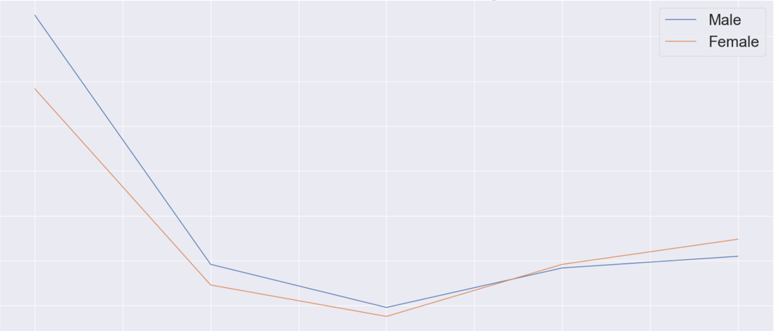
Explanation of insights
The trend of prices for insurance are of a slight v shape, heavily skewed towards consumers of a younger age.
This is probably due to:
lack experience and time driving
We can observe an average price for insurance plans at $2150 for both genders at 20 years old
This value drops significantly 20 years later, by about 30%, as:
seasoned drivers, and are less likely to get into an accident
However, this value increases by about 10% as we move older, since:
elderly may face issues paying attention or having similar road awareness to their 40-year-old counterparts

Slide 32
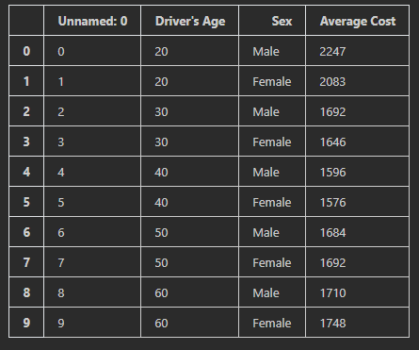
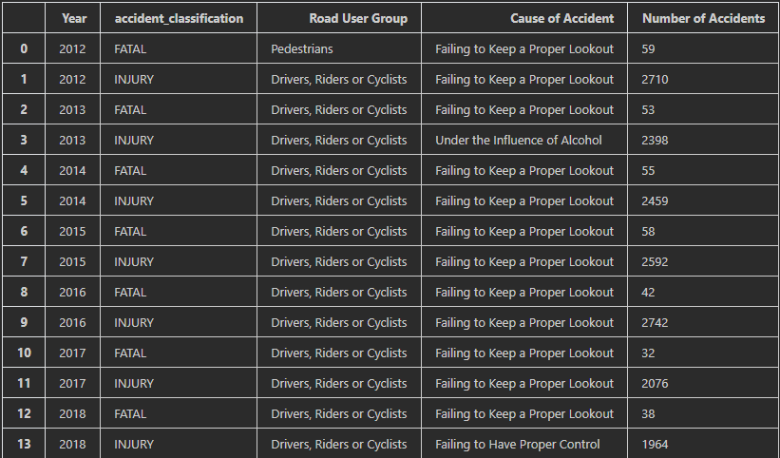
Data Dictionary
Average cost of insurance, per gender, per age group
No. of accidents per cause of accident, per road user group, per accident classification, per year

Slide 33

Where should I park my car? What should I look out for?

Slide 34



Explanation of insights
Distribution of lots present in carpark
The proportion of lots available is linear to that of the number of lots present
However, these values become more fanned out, causing
The reliability of the data and consistency of the data to drop
The data not to follow the trendline
Even though the carpark has more lots, it doesn't mean that there will be as many available for me to park in
Even though there are more than 1200 lots, it has lesser lots available for me to park in compared to this car park with 4 times as little lots present.
Since carparks are just simply occupied
This trend is more common for residential carparks, where majority of the lots are already being used
Solution? We can pay about $12 a day for seasonal parking (HDB,2022)
Distribution of available lots

Slide 35

what are my needs for a carpark? What type of carpark suits those needs?

Slide 36
Explanation of insights
We can observe from the distribution of Car Park and Car Park Facilities that:
The majority of car parks are either Surface, or Multi-Storey, accounting for up to 85% of all car parks in Singapore, suggesting that these types of car parks take precedence over the rarer car park types, such as mechanised car parks, since Singapore needs to cater to the majority of drivers.
The majority of these car parks operate through electronic parking, about 90% of the time, with the other 10% being coupons suggesting that Singapore has been making moves to modernise its car park infrastructure
The majority of these multi storey car parks, have roughly 10 to 12 decks, suggesting that that is the preferred height for car parks, and that almost all coupon parking car parks are built on the surface as they have 0 decks.
Therefore, to have the best shot at find a parking spot, we should find a carpark with those specifications

Slide 37


Data Dictionary
Distribution of Car Park Type, Type of Parking System, Gantry Height, No. of Car Park Decks and availability of:
1) Free Parking
2) Night Parking
3) Car Park Basement
No. of lots available per no. of lots present

Slide 38
Conclusion of insights & recommendations
What are the most popular brand of cars sold and their respective models?
Toyota, with the Toyota Corolla, as it is reliable, efficient and budget friendly. Therefore, I recommend to purchase the Corolla
What road facilities am I provided with as a car buyer?
Annually-increasing road length
Annually increasing transport facilities and services such as Vehicular Bridges, Vehicle Underpass Tunnels, Traffic Lights etc.
How much are average fuel prices?
Average fuel prices are about $3.10 per liter, however due to volatile and unpredictable market conditions, said values may be prone to fluctuation.
How congested is Singapore? How many cars are on the road and how fast can I drive?
In terms of jam density, there is a 69.5% possibility to be caught in a jam in Singapore, if we consider the average number of vehicles per km in a jam to be 400.
Up by 1.4km/h since 2005, you can drive at an average speed of 64.1 Km/h on expressways, and 28.9 Km/h on arterial roads such as Orchard Road.
What are the most common accidents? If I get into an accident, what are the average vehicle insurance prices
The most common accidents occur when Drivers, Riders or Cyclists fail to keep a proper lookout on the road.
Such accidents require insurance prices that vary from age group to age group, with the most expensive being $2,247 for male adults in their 20’s, and the lowest being $1,576 for female adults in their 40’s.
After I’m done driving, where do I park my car?
The most common and easily accessible carparks available for usage are 10-12 deck multi-storey carparks that offer electronic parking, therefore I recommend to either find a carpark with said specifications, or spend $12 a day for season parking

Slide 39
credits
Amanda S., 2022. Why Is The Toyota Brand So Popular Among Consumers? [online] Driver’s AutoMart Available at: Why Is The Toyota Brand So Popular Among Consumers? (driversautomart.com) [Accessed 14 February 2022]
2022 Toyota Camry [online] US News Available at: 2022 Toyota Camry Prices, Reviews, & Pictures | U.S. News (usnews.com) [Accessed 14 February 2022]
Offical PR, 2022 Toyota Camry [online] WheelZome Available at: Why Is Toyota Corolla The World's Best-Selling Car? | Wheelz.me English [Accessed 14 February 2022]
See Kit, Tang,. 2022 Why are gas prices on the rise and what does this mean for Singapore? [online] CNA Available at: Why are gas prices on the rise and what does this mean for Singapore? - CNA (channelnewsasia.com) [Accessed 14 February 2022]

